Slide 1
Personalized Recommender for Implicit Data
Walmart Internship Report
Zehao Guan, 2019/08/01

Slide 2
Introduction
Project
Future Work
Conclusion

Slide 3
Introduction
Project
Future Work
Conclusion

Slide 4
Abstract
Target
Design a personalized recommendation system for implicit feedback data.
Methods
Latent factor model based collaborative filtering, like pointwise/pairwise matrix factorization and factorization machine with libFM.
Experiment
Split into train/validation data in temporal manner;
Apply ranking based metrics for model evaluation.
Notes:
In this intern project, the target is to design a personalized recommendation system for implicit feedback data. We implement latent factor model based collaborative filtering, including pointwise/pairwise (BPR) non-negative matrix factorization and factorization machine methods. To evaluate the proposed model, we perform the experiment in following steps. On one hand, to capture sequential users’ purchase behavior, we split into the train/validation data in temporal manner. On the other hand, as items ranked higher should be more preferred by customers, ranking based metrics such as HR, MAP and NDCG are applied. Our experiment on Walmart.com transaction data shows potential improvement on top-N recommendation performance.

Slide 5
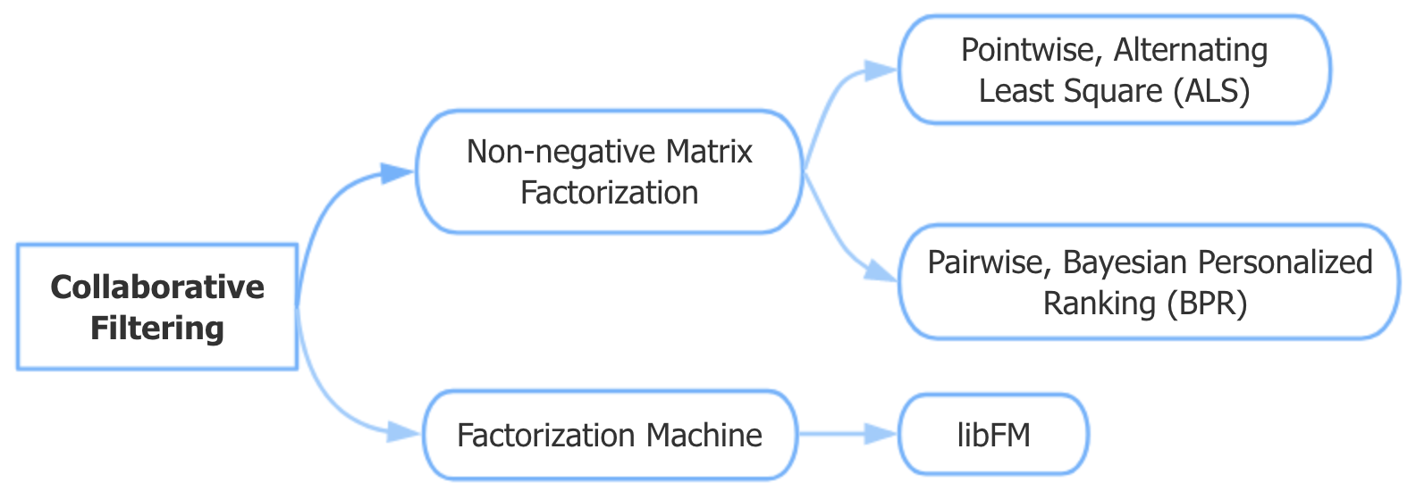
Sketch

Slide 6
Introduction
Project
Future Work
Conclusion

Slide 7
Background
Unlike extensively researched explicit feedback, no direct input from the users regarding their preferences.
Treat transaction data as indication of positive and negative preference associated with varying confidence levels.
Should design a scalable optimization procedure and explainable factor model for recommendations.
The target is to realize top-N personalized recommendation based on users’ response.

Slide 8
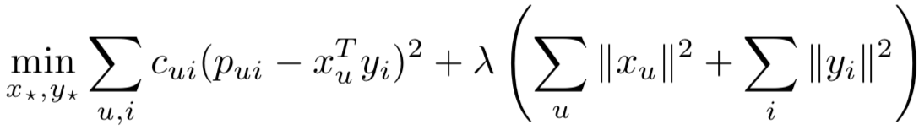
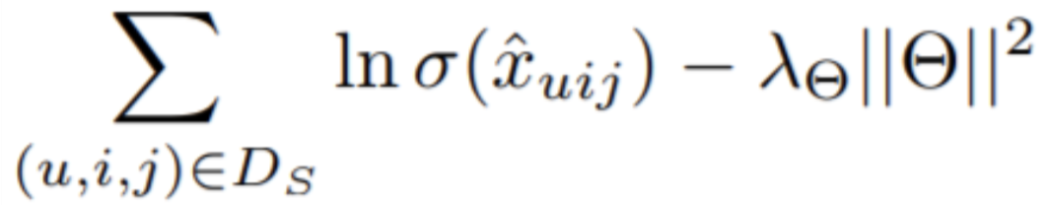
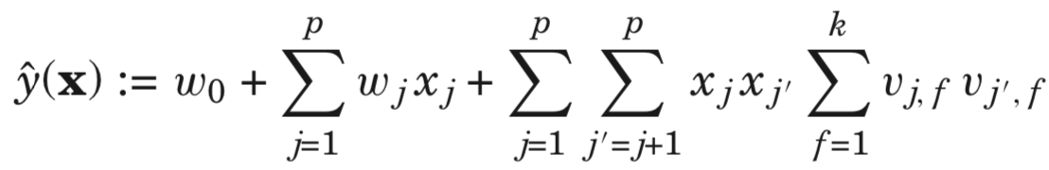
Algorithm
Pointwise NMF, Alternating Least Square (ALS)
Pairwise NMF, Bayesian Personalized Ranking (BPR)
Factorization Machines with libFM
Notes:
ALS starts by treating one set of latent factors as constant and update the other.
Optimization would be performed based on the rank of these user-item pairs instead of scoring just on the user-item interaction.
FMs combine the high-prediction accuracy of factorization models with the flexibility of feature engineering.

Slide 9
Experiment Design
To capture sequential users’ purchase behavior, split into train/validation data in temporal manner.
As items ranked higher should be more preferred by users, ranking based metrics are applied.
Start with demos on small-scale data, and then improve the scalability.

Slide 10
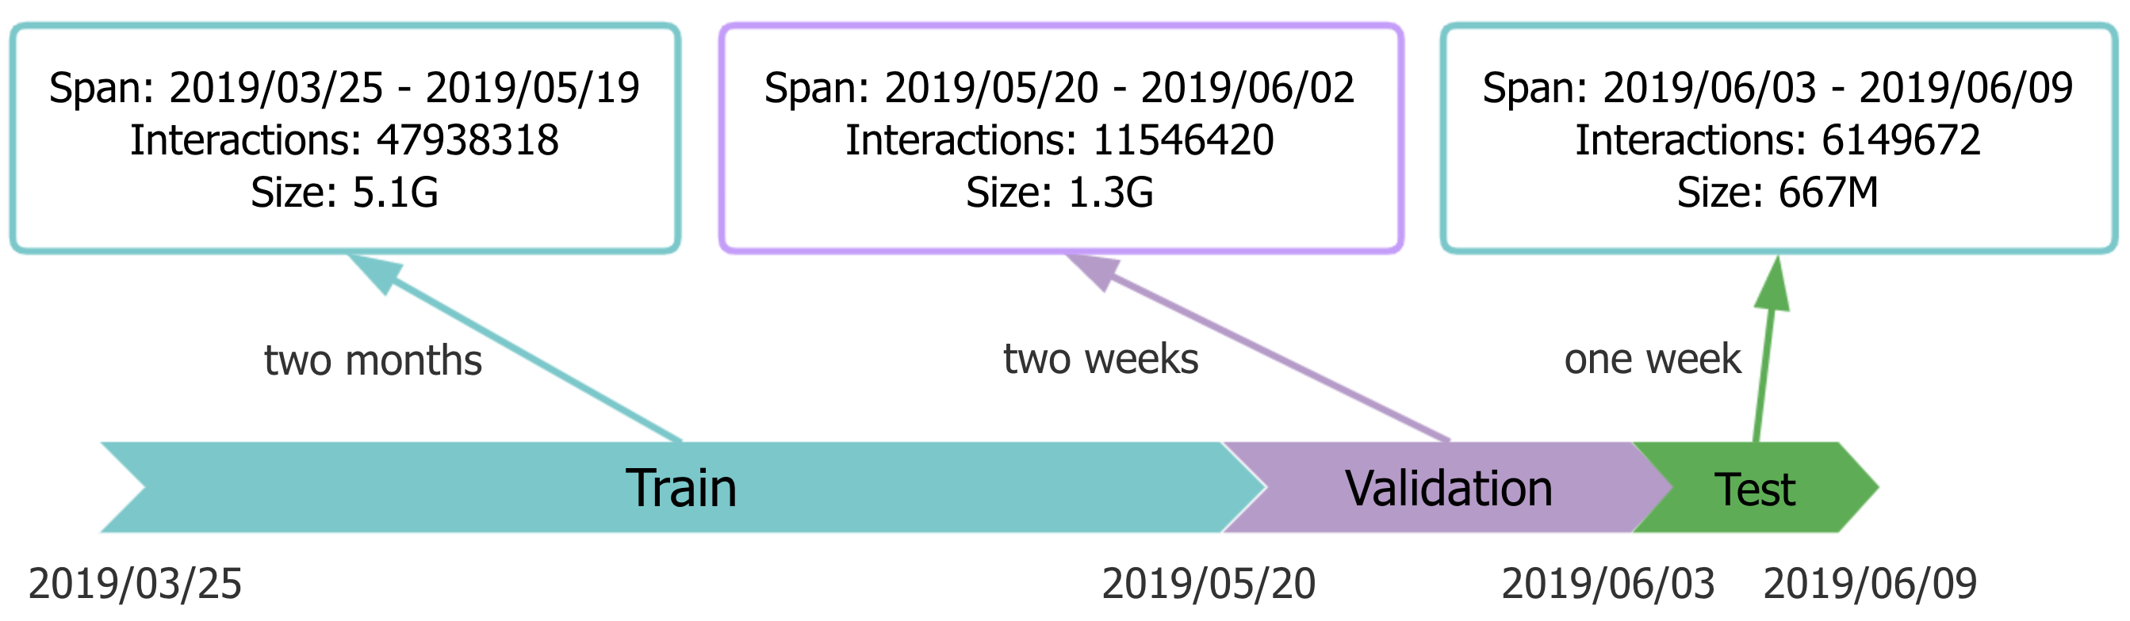
Temporal Manner

Slide 11
Ranking Metrics
Hit ratio (HR)
Normalized discounted cumulative gain (NDCG)
Mean average precision (MAP)
Area under curve (AUC)
Top-N recommendation !

Slide 12
Data
Database: ucid
Table: common_transaction_model
Source: Walmart.com
Columns: cid, catalog_item_id, purchase_date
Features:
Implicit feedback
High sparsity
Imbalance

Slide 13
Preprocess
Clean outliers like infrequent customers/items and resellers.
Map user and item ids to categorical values.
Store observed data in <userId, itemId, rating> triple format.
Convert to sparse matrix for other operations.
Sample data in demo:
Ignore: 14847105 * 2958922
Raw: 14929995 * 3008950
Processed: 34209 * 47857
density: 0.0712%

Slide 14
Train
< 15
Assume n_iters that is enough for the loss to converge.

Slide 15
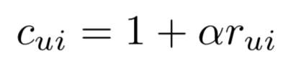

Evaluation
Tune on parameters like _lambda and alpha.

Slide 16
Evaluation
Extend scale to 0~400, and select best n_factors for test, also consider computation cost and avoid over-fitting.

Slide 17
Evaluation – Model selection
Top-k
0/1 v.s. normalized frequency

Slide 18
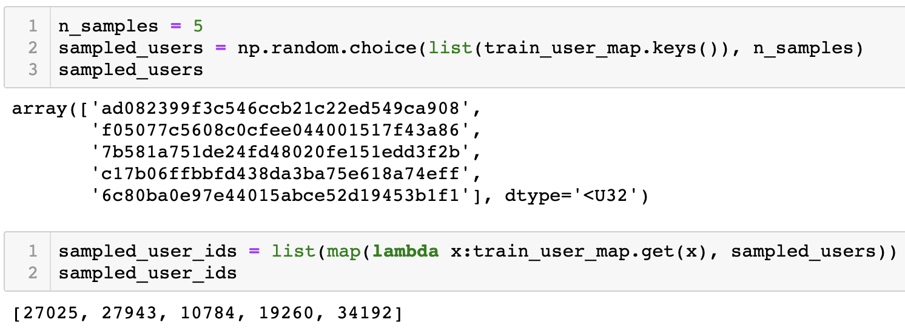
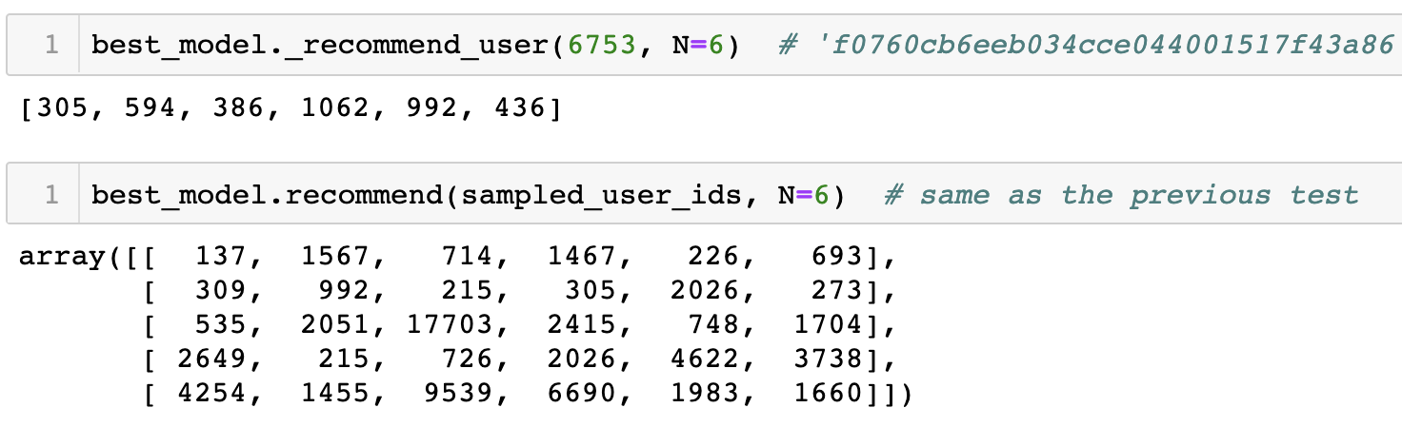
Test – Recommend for users
cid
user_id
item_id
https://gecgithub01.walmart.com/z0g00mx/Intern_project/blob/master/als.ipynb

Slide 19
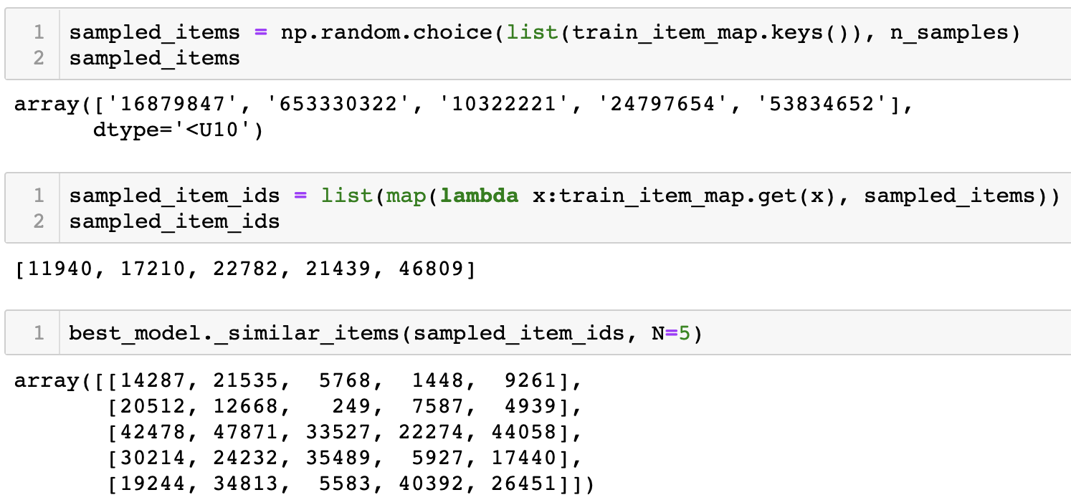
Test – Find similar items
catalog_item_id
item_id
https://gecgithub01.walmart.com/z0g00mx/Intern_project/blob/master/als.ipynb

Slide 20
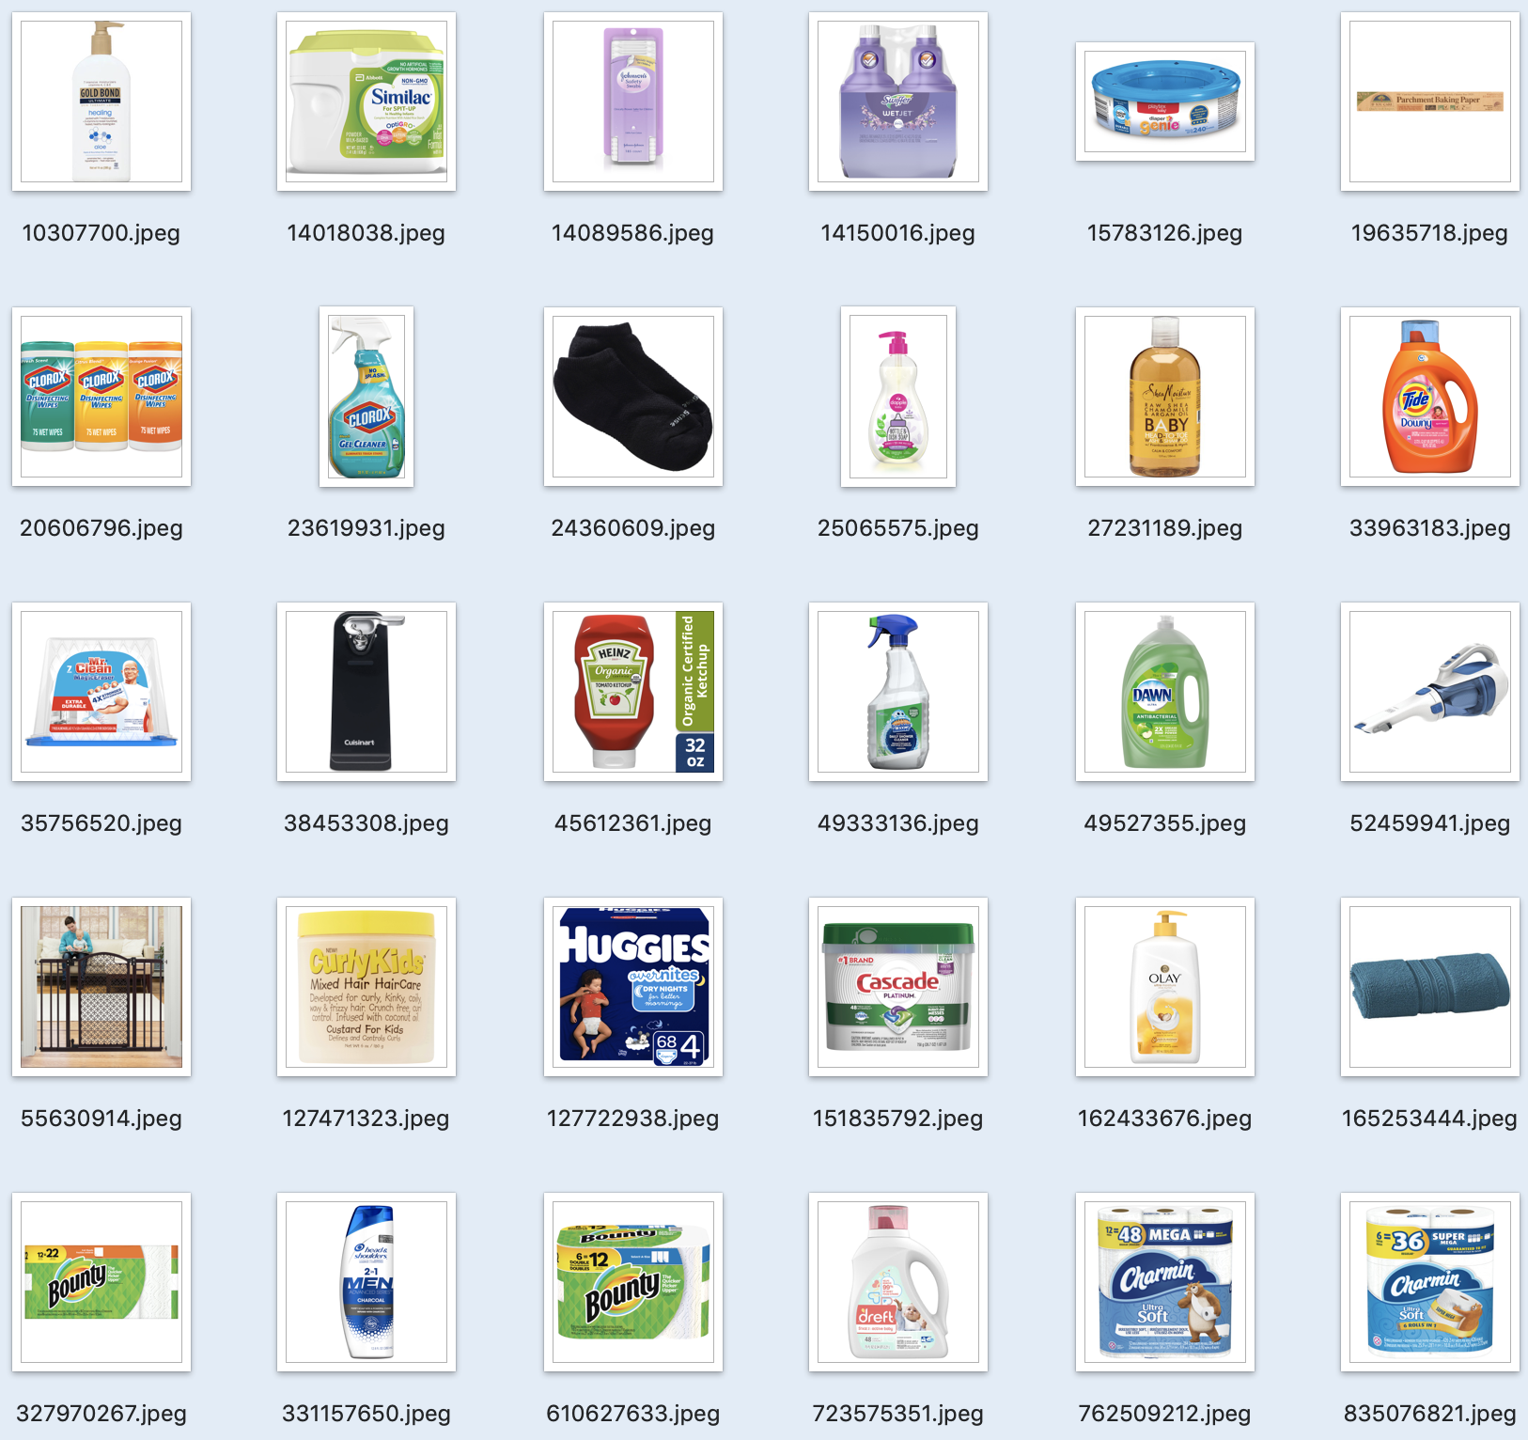
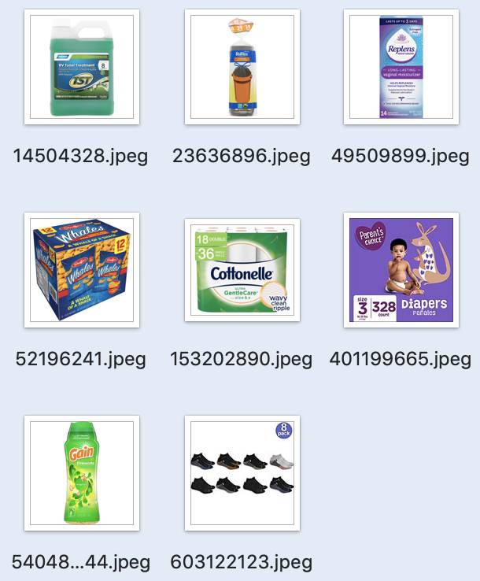
Test – Case study
Recommend
Top-8 recommended items
User purchase history

Slide 21
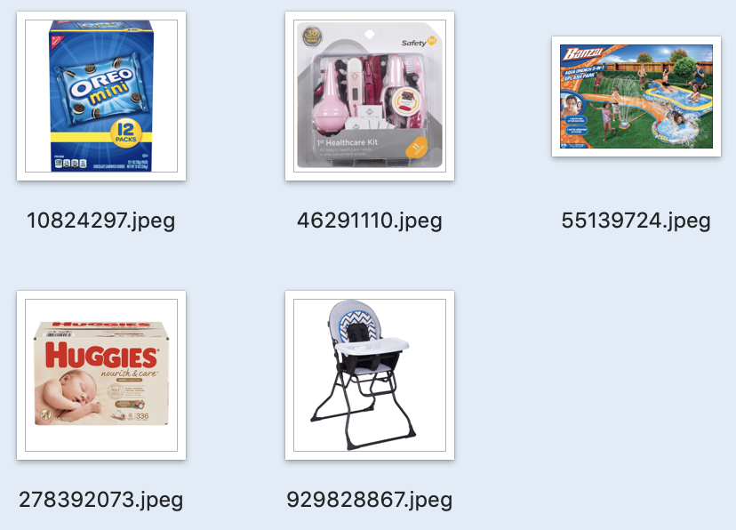
Test – Case study
Similar
Sampled item
Top-5 similar items
(KNN, Euclidean metric)

Slide 22
Analysis
Separability of latent factors with t-SNE, K-means
Pointwise method performs better than BPR

Slide 23
Accomplishment
Three recommender demos in same experimental procedures with Walmart.com transaction data.
Code implementation for large-scale data.
(1856520 * 831859)
Write bash scripts to use libFM by C++ for matrix factorization to get latent factors.
Python codes for preprocessing, ranking metrics evaluation and personalized recommendation.
https://gecgithub01.walmart.com/z0g00mx/Intern_project/tree/master/CF_libFM

Slide 24
Introduction
Project
Future Work
Conclusion

Slide 25
Future Work
Realize industrial level APIs of the recommender demos.
Evaluate the model with different sources of data.
Besides these baseline models, explore more advanced methods for matrix factorization and optimization.

Slide 26
Introduction
Project
Future Work
Conclusion

Slide 27
Challenge
Inexperience with recommendation system for implicit feedback dataset.
Lots of efforts to process highly sparse and unbalanced transaction data.
Difficulty to apply PySpark for evaluating ranking metrics.
Problems in face of scalability.

Slide 28
What I’ve learnt
Tools like Hive, Spark, Kubernetes, libFM…
More familiar with libraries like pandas, scipy, sklearn…
Knowledge about the field of implicit recommendation, like classic models and widely-used ranking methods.
Experience with experiments design and conduct.
Capability to learn by doing.

Slide 29
Reference
Hu, Yifan, Yehuda Koren, and Chris Volinsky. "Collaborative filtering for implicit feedback datasets." 2008 Eighth IEEE International Conference on Data Mining. Ieee, 2008.
Koren, Yehuda, Robert Bell, and Chris Volinsky. "Matrix factorization techniques for recommender systems." Computer8 (2009): 30-37.
Rendle, Steffen, et al. "BPR: Bayesian personalized ranking from implicit feedback." Proceedings of the twenty-fifth conference on uncertainty in artificial intelligence. AUAI Press, 2009.
Rendle, Steffen. "Factorization machines with libfm." ACM Transactions on Intelligent Systems and Technology (TIST)3.3 (2012): 57.

Slide 30
Appendix
GitHub link:
https://gecgithub01.walmart.com/z0g00mx/Intern_project

Slide 31
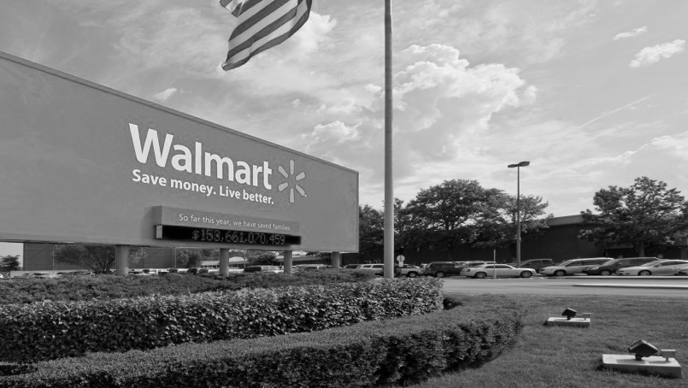
Thank You!

